Slide 1

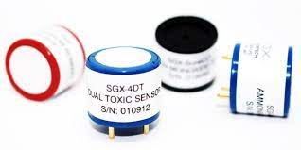
Shri Ramdeobaba College Of Engineering and Managment Nagpur
Department of
Electronics and Communication Engineering
Academic Session 2023-2024
Presentation on - Electrochemical Gas Sensor
Course Name - Smart Sensors
Presented by:-
Name:-Ganesh Narayan Moroliya
Section: A
Roll No:-102

Slide 2
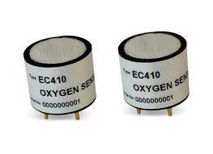
Contents:-
1. Introduction
2.Working
3. Applications of Electrochemical Gas Sensors
4. Advantages and Limitations
5. Conclusion

Slide 3
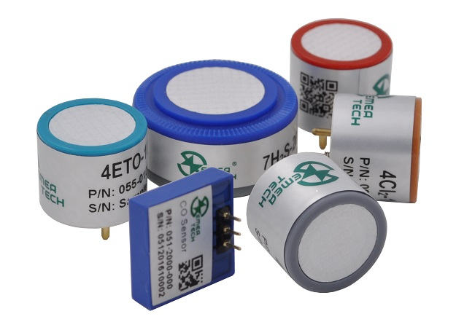
Introduction :-
An electrochemical gas sensor is a device designed to detect the presence of specific gases in the surrounding environment through electrochemical reactions. These sensors are widely used in various applications, including industrial safety, environmental monitoring, medical diagnostics. The fundamental principle behind electrochemical gas sensors is the conversion of a chemical reaction into an electrical signal, which can be measured and interpreted to determine the concentration of the target gas.
MEu-O2 Oxygen Sensor
ME4-ETO Ethylene Oxide Gas Sensor
ME4-SO2 Sulfur Dioxide Gas Sensor
ME4-CO Carbon Monoxide Gas Sensor

Slide 4
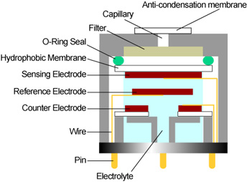
Working :-
Gas molecules enter the sensor and first face an anti-condensation membrane, providing protection against moisture and dust.
The gas molecules then pass through a capillary, potentially Crossing a subsequent filter, controlling and preparing the gas flow.
Filter removes unwanted gases.
O-Ring seal prevent leakage of gas.
Hydrophobic Membrane allow gas molecules towards sensing electrode
Sensing electrode coated with material that reacts with targeted gas.(Electrochemical reaction) Reduces or increases electrons.
Reference electrodes has fixed voltage comparing with sensing electrode potential.
Counter Electrode completes the circuit .

Slide 5

Applications of Electrochemical Gas Sensors
Industrial Safety (EC0-5011)
Environmental Monitoring
Monitor toxic gases in factories and laboratories to ensure the safety of workers.
Detect harmful gases in the air, water, and soil to protect the environment
Indoor Air Quality
Medical Diagnosis
Measure gas levels in indoor spaces to maintain a healthy living and working environment.
Diagnose diseases by analyzing the gases emitted by the human body.
Advantages and Limitations
Advantages
Limitations
Precision in measurement, quick response time, long lifespan, and low power consumption.
Interference from other gases, high cost of manufacturing, and limited detection range for certain gases.

Slide 6
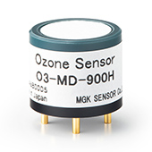
Conclusion:-
In conclusion, electrochemical gas sensors are essential tools in gas detection, offering a durable solution across diverse applications. As technology evolves, electrochemical gas sensors continue to be essential, playing a crucial role in safety, health, and environmental sustainability.

Slide 7
Thank You

